Slide 1
E-Commerce Data Visualization
By Anh Kien Le

Slide 2

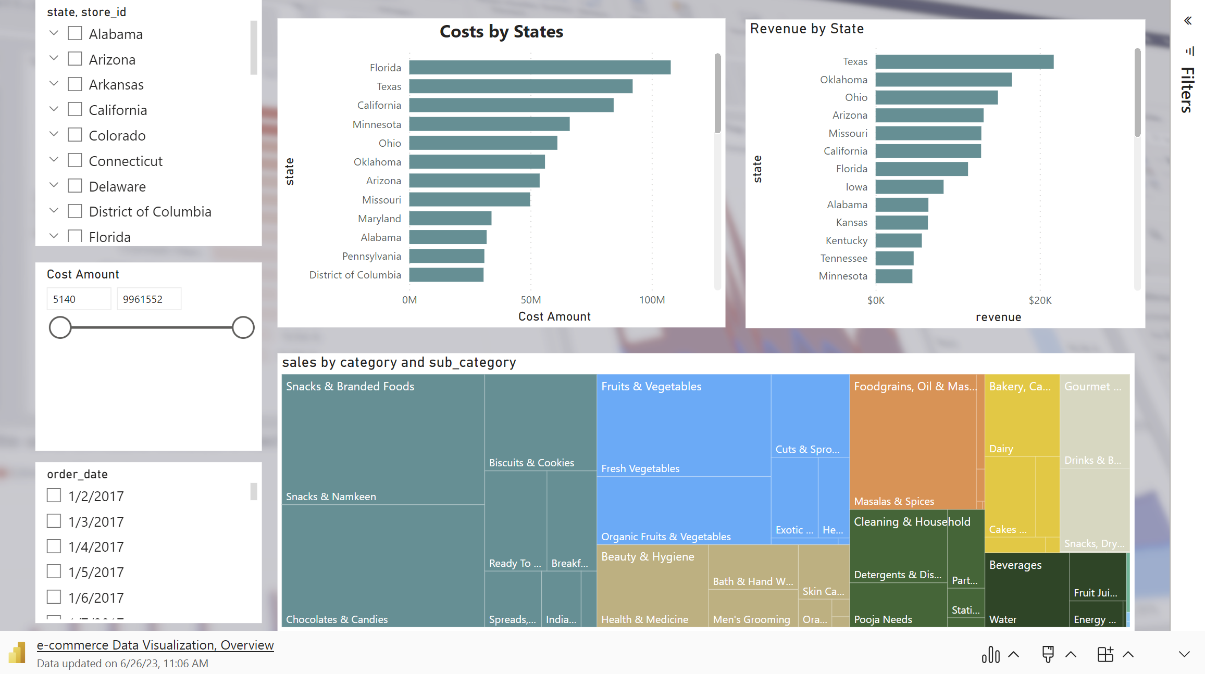
Revenue and Costs Overview

Slide 3
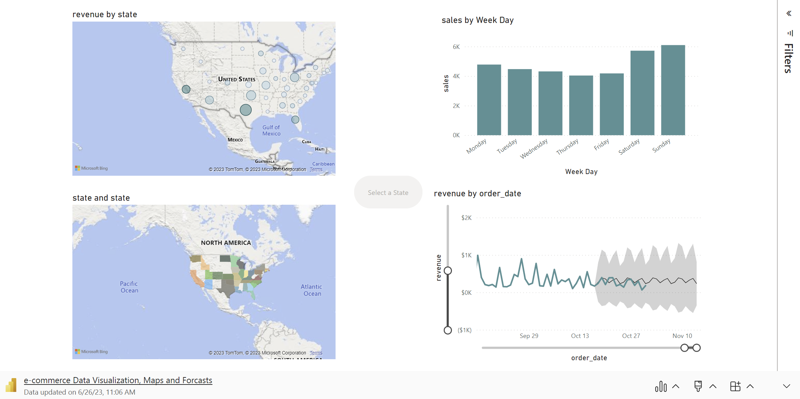
Revenue and Sales by Week Day

Slide 4
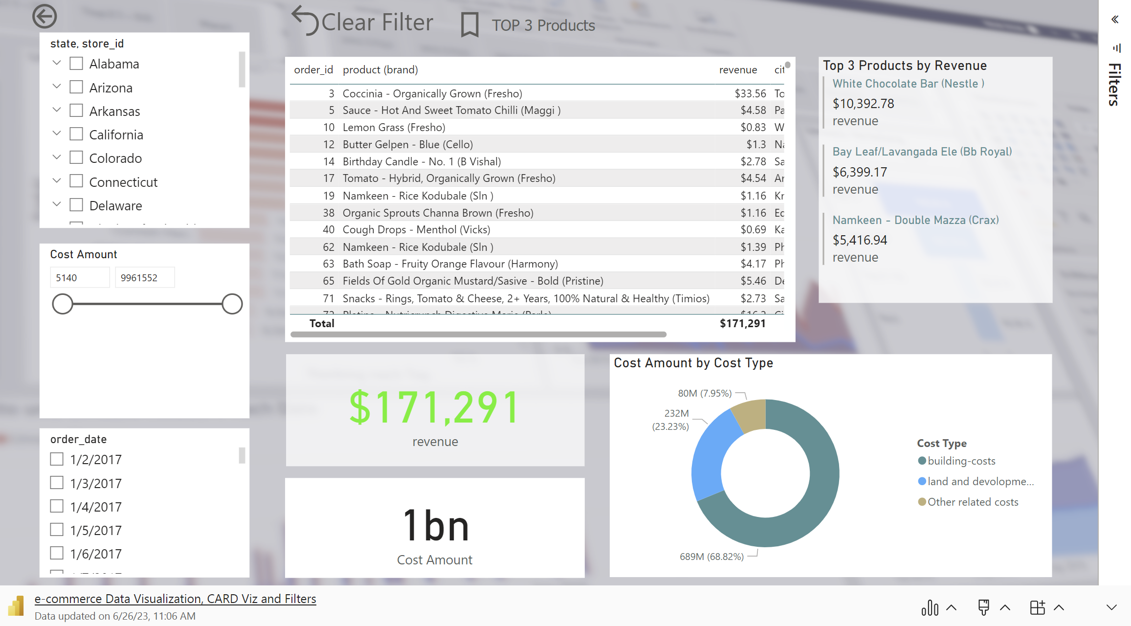
Revenue and Costs Overview

Slide 5
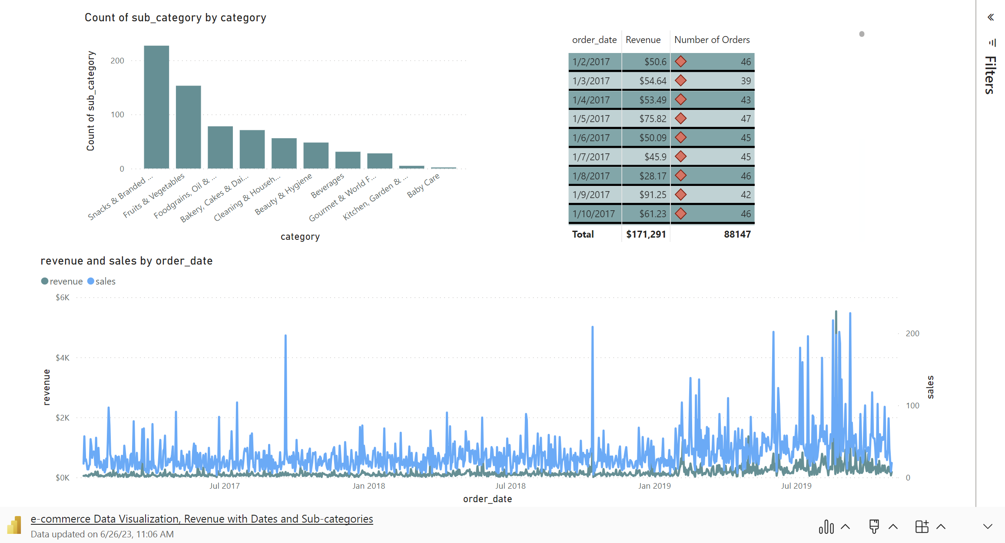
Revenue and Costs Overview

